Slide 1


Feature Selection

Slide 2
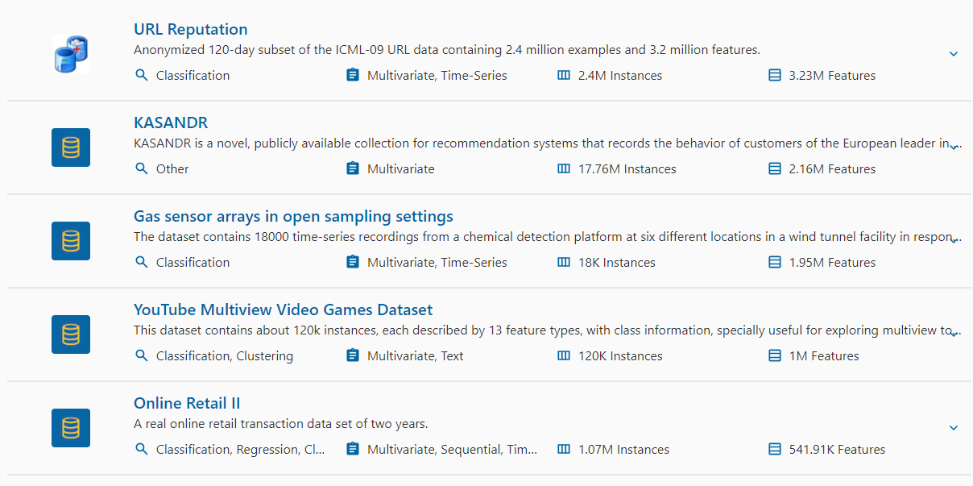
Characteristics of SVM
Problem in the real world.
https://archive.ics.uci.edu/

Slide 3
Characteristics of SVM
Feature Selection
Improves Model Performance: Removing irrelevant or redundant features can lead to better accuracy, precision, and recall in the model’s predictions.
Reduces Training Time: With fewer features, the model requires less computational power and time to train, making the process more efficient.
Simplifies Models: A model with fewer features is easier to interpret and understand, which is beneficial for explaining the results to stakeholders.
Enhances Generalization: By focusing on the most important features, the model is more likely to generalize well to new, unseen data.
Reduces Noise: Eliminating irrelevant features helps reduce the noise in the data, leading to cleaner and more robust models.
Improves Data Understanding: The process of feature selection helps in better understanding the data and identifying the most influential variables.
Optimizes Resource Usage: Reducing the number of features can save storage and processing resources, which is particularly important in large-scale applications.
Reduces Overfitting: By selecting only the most relevant features, it decreases the complexity of the model, which helps prevent overfitting.

Slide 4
Characteristics of SVM
Feature Selection – When
High-Dimensional Data: When you have datasets with a large number of features, feature selection helps to reduce dimensionality, making the model more manageable and less prone to overfitting.
Improving Interpretability: When you need a model that is easy to interpret and explain to stakeholders, feature selection can simplify the model by focusing on the most important features.
Reducing Computational Costs: If training a model is time-consuming or resource-intensive due to a large number of features, feature selection can significantly reduce computational requirements.
In Preprocessing Pipelines: Feature selection is often used as a step in data preprocessing pipelines to prepare the data for more effective machine learning.
Before Applying Complex Models: When planning to use complex or ensemble models, reducing the feature space beforehand can make the process more efficient and lead to better performance.

Slide 5
Characteristics of SVM
Feature Selection – Types
Filter Method
Wrapper Methods
Filter Method
“Filter methods evaluate the relevance of features by examining their statistical properties independently of any machine learning algorithm. These methods are typically faster and simpler”
  Correlation: Measures the linear correlation between each feature and the target variable.
  Chi-Square Test: Assesses the association between categorical features and the target variable.
  ANOVA (Analysis of Variance): Compares the means of different features to see if they are significantly different with respect to the target variable.
  Mutual Information: Measures the dependency between the feature and the target variable.
  Variance Threshold: Removes all features with low variance, assuming low variance features are less important.

Slide 6
Characteristics of SVM
Feature Selection – Types
Wrapper Method
“Wrapper methods involve selecting features by actually training a model and evaluating its performance with different subsets of features. These methods consider the interactions between features and the model's performance as a selection criterion.”
  Forward Selection: Starts with an empty set of features and adds one feature at a time. At each step, it evaluates the model's performance with each candidate feature added to the current set and selects the feature that improves the model's performance the most.
  Backward Elimination: Backward Elimination starts with all features included in the model and removes the least significant feature one at a time. At each step, the feature whose removal results in the smallest drop in performance (or the largest improvement) is eliminated.

Slide 7
Characteristics of SVM
Correlation
Correlation
A statistical measure that describes the strength and direction of the relationship between two variables.
Quantifies how much one variable changes in response to changes in another.
Correlation is widely used in data analysis to determine the degree of association between variables, which can help in identifying patterns, making predictions, and guiding decision-making.
Direction:
  Positive Correlation: When one variable increases, the other also increases. For example, height and weight typically have a positive correlation.
  Negative Correlation: When one variable increases, the other decreases. For example, the number of hours spent on social media might negatively correlate with academic performance.
  No Correlation: No consistent pattern of association; the variables are independent of each other.
Types of correlation:
  Pearson
  Spearman
  Kindle

Slide 8
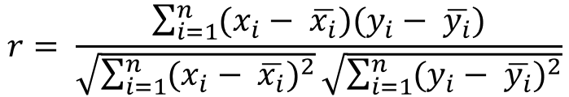
Correlation - Pearson
Measures the linear relationship between two continuous variables.
Assumes the data is normally distributed and the relationship is linear.
Range is from -1 to +1.
  +1: Indicates a perfect positive linear relationship between the two variables.
  0: Indicates no linear relationship between the variables.
  -1: Indicates a perfect negative linear relationship between the two variables.
Test score (out of 10) | Hours playing video games per week
8 | 2
3 | 2
5 | 1.5
7 | 1
1 | 2.5
2 | 3
6 | 1.5
7 | 2
4 | 2
9 | 1.5
$$r= \frac{\sum_{i=1}^{n}{(x_{i}− \overline{x_{i}})(y_{i}− \overline{y_{i}})}}{\sqrt{\sum_{i=1}^{n}{{(x_{i}− \overline{x_{i}})}^{2}}}\sqrt{\sum_{i=1}^{n}{{(y_{i}− \overline{y_{i}})}^{2}}}}$$

Slide 9
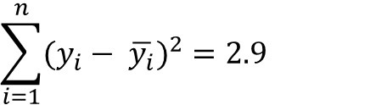
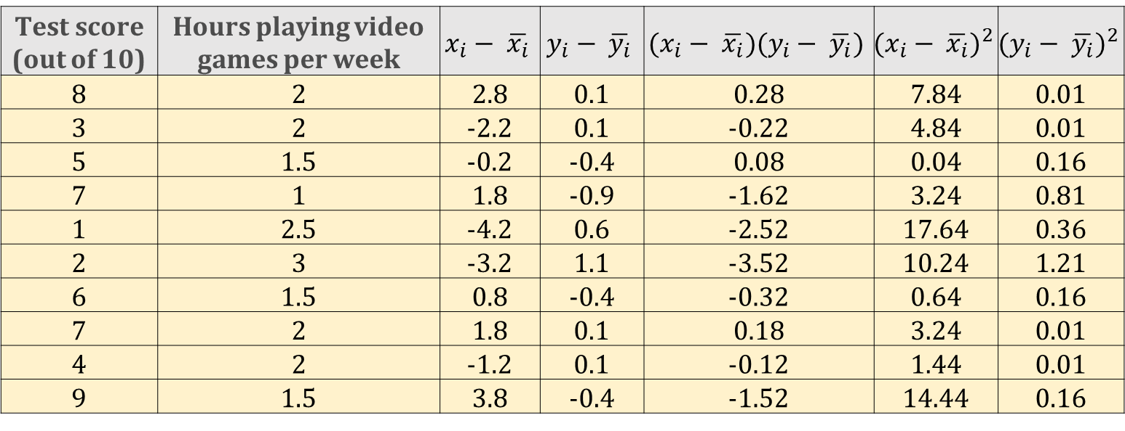
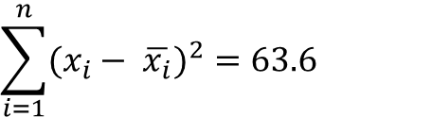
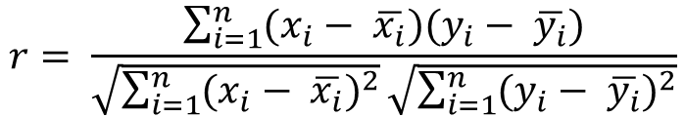
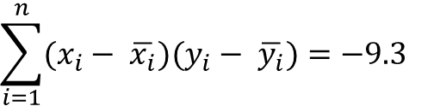


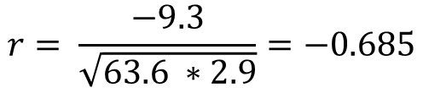
$$r= \frac{\sum_{i=1}^{n}{(x_{i}− \overline{x_{i}})(y_{i}− \overline{y_{i}})}}{\sqrt{\sum_{i=1}^{n}{{(x_{i}− \overline{x_{i}})}^{2}}}\sqrt{\sum_{i=1}^{n}{{(y_{i}− \overline{y_{i}})}^{2}}}}$$
Correlation - Pearson
Test score (out of 10) | Hours playing video games per week | $$x_{i}− \overline{x_{i}}$$ | $$y_{i}− \overline{y_{i}}$$ | $$(x_{i}− \overline{x_{i}})(y_{i}− \overline{y_{i}})$$ | $${(x_{i}− \overline{x_{i}})}^{2}$$ | $${(y_{i}− \overline{y_{i}})}^{2}$$
8 | 2 | 2.8 | 0.1 | 0.28 | 7.84 | 0.01
3 | 2 | -2.2 | 0.1 | -0.22 | 4.84 | 0.01
5 | 1.5 | -0.2 | -0.4 | 0.08 | 0.04 | 0.16
7 | 1 | 1.8 | -0.9 | -1.62 | 3.24 | 0.81
1 | 2.5 | -4.2 | 0.6 | -2.52 | 17.64 | 0.36
2 | 3 | -3.2 | 1.1 | -3.52 | 10.24 | 1.21
6 | 1.5 | 0.8 | -0.4 | -0.32 | 0.64 | 0.16
7 | 2 | 1.8 | 0.1 | 0.18 | 3.24 | 0.01
4 | 2 | -1.2 | 0.1 | -0.12 | 1.44 | 0.01
9 | 1.5 | 3.8 | -0.4 | -1.52 | 14.44 | 0.16
$$\overline{x}=\frac{\sum_{i=1}^{n}{x_{i}}}{n}=\frac{52}{10}=5.2$$
$$\sum_{i=1}^{n}{{(x_{i}− \overline{x_{i}})}^{2}}=63.6$$
$$r= \frac{−9.3}{\sqrt{63.6 ∗2.9}}=−0.685$$
$$\overline{y}=\frac{\sum_{i=1}^{n}{y_{i}}}{n}=\frac{19}{10}=1.9$$
$$\sum_{i=1}^{n}{{(y_{i}− \overline{y_{i}})}^{2}}=2.9$$
Moderate to strong negative correlation between the test scores and the hours spent playing video games.
$$\sum_{i=1}^{n}{(x_{i}− \overline{x_{i}})(y_{i}− \overline{y_{i}})}=−9.3$$

Slide 10

Correlation - Spearman
The Spearman correlation coefficient is a non-parametric measure of rank correlation.
It assesses how well the relationship between two variables can be described using a monotonic function.
For linear and non linear relationship.
Range is from -1 to +1.
  +1: Indicates a perfect positive linear relationship between the two variables.
  0: Indicates no linear relationship between the variables.
  -1: Indicates a perfect negative linear relationship between the two variables.
Test score (out of 10) | Hours playing video games per week
8 | 2
3 | 2
5 | 1.5
7 | 1
1 | 2.5
2 | 3
6 | 1.5
7 | 2
4 | 2
9 | 1.5
$$ρ= \frac{1 −6\sum{d_{i}^{2}}}{n\left(n^{2} −1\right)}$$
$d_{i}$is the difference between the ranks of corresponding values of $x$ and $y$
$n$ is the number of data points

Slide 11
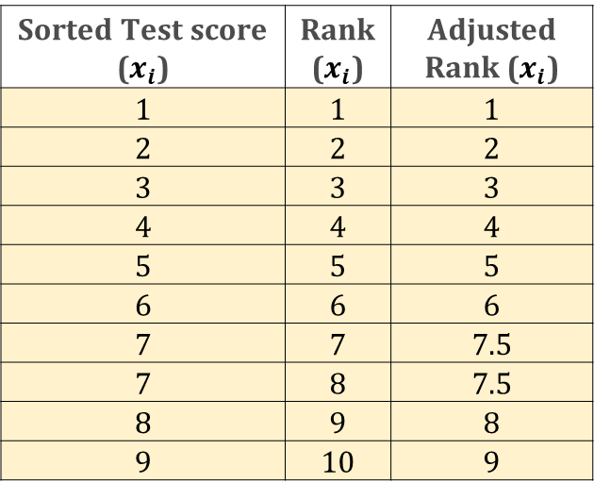
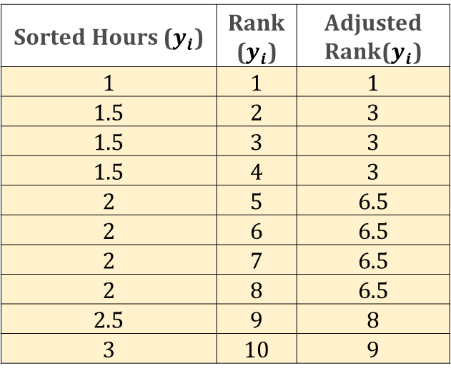
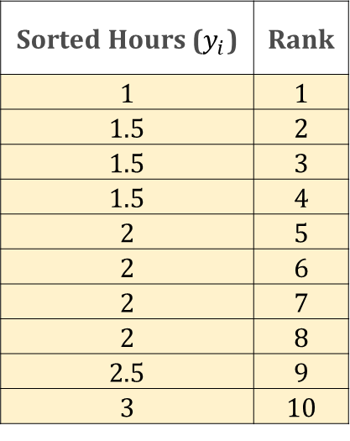
Correlation - Spearman
Rank the data
Rank the data
Sorted Test score ($x_{i}$) | Rank ($x_{i}$) | Adjusted Rank ($x_{i}$)
1 | 1 | 1
2 | 2 | 2
3 | 3 | 3
4 | 4 | 4
5 | 5 | 5
6 | 6 | 6
7 | 7 | 7.5
7 | 8 | 7.5
8 | 9 | 8
9 | 10 | 9
Sorted Hours ($y_{i}$) | Rank ($y_{i}$) | Adjusted Rank($y_{i}$)
1 | 1 | 1
1.5 | 2 | 3
1.5 | 3 | 3
1.5 | 4 | 3
2 | 5 | 6.5
2 | 6 | 6.5
2 | 7 | 6.5
2 | 8 | 6.5
2.5 | 9 | 8
3 | 10 | 9
Test score (out of 10) | Hours playing video games per week
8 | 2
3 | 2
5 | 1.5
7 | 1
1 | 2.5
2 | 3
6 | 1.5
7 | 2
4 | 2
9 | 1.5
Sorted Test score (out of 10) | Rank
1 | 1
2 | 2
3 | 3
4 | 4
5 | 5
6 | 6
7 | 7
7 | 8
8 | 9
9 | 10
Sorted Hours ($y_{i}$) | Rank
1 | 1
1.5 | 2
1.5 | 3
1.5 | 4
2 | 5
2 | 6
2 | 7
2 | 8
2.5 | 9
3 | 10
Handle Ties
Handle Ties
Tied Ranks are 7 & 8
Tied Ranks are 2,3 & 4
Average rank for both values of 7: $A=\frac{2+3+4}{3}=3$
Average rank for both values of 7: $A=\frac{7+8}{2}=7.5$
Tied Ranks are 5,6,7 & 8
Average rank for both values of 7: $A=\frac{5+6+7+8}{4}=6.5$

Slide 12
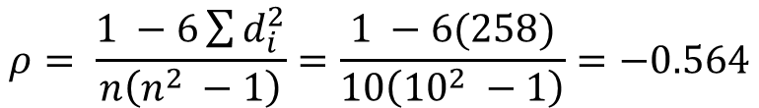
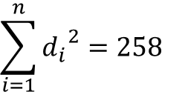
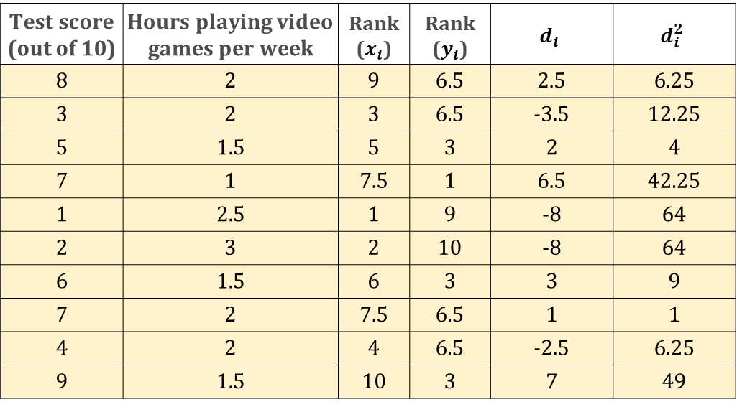
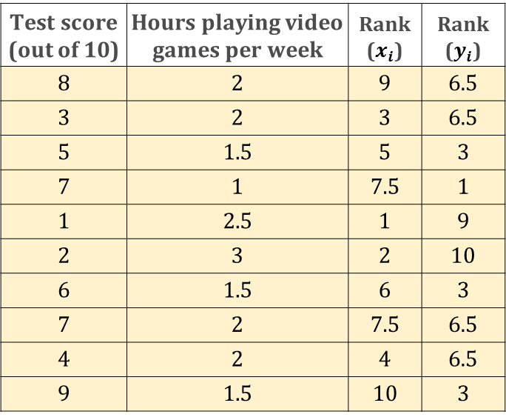
Correlation - Spearman
Test score (out of 10) | Hours playing video games per week | Rank ($x_{i}$) | Rank ($y_{i}$)​ | $$d_{i}$$ | $$d_{i}^{2}$$
8 | 2 | 9 | 6.5 | 2.5 | 6.25
3 | 2 | 3 | 6.5 | -3.5 | 12.25
5 | 1.5 | 5 | 3 | 2 | 4
7 | 1 | 7.5 | 1 | 6.5 | 42.25
1 | 2.5 | 1 | 9 | -8 | 64
2 | 3 | 2 | 10 | -8 | 64
6 | 1.5 | 6 | 3 | 3 | 9
7 | 2 | 7.5 | 6.5 | 1 | 1
4 | 2 | 4 | 6.5 | -2.5 | 6.25
9 | 1.5 | 10 | 3 | 7 | 49
Test score (out of 10) | Hours playing video games per week | Rank ($x_{i}$) | Rank ($y_{i}$)​
8 | 2 | 9 | 6.5
3 | 2 | 3 | 6.5
5 | 1.5 | 5 | 3
7 | 1 | 7.5 | 1
1 | 2.5 | 1 | 9
2 | 3 | 2 | 10
6 | 1.5 | 6 | 3
7 | 2 | 7.5 | 6.5
4 | 2 | 4 | 6.5
9 | 1.5 | 10 | 3
$$\sum_{i=1}^{n}{{d_{i}}^{2}}=258$$
$$ρ= \frac{1 −6\sum{d_{i}^{2}}}{n\left(n^{2} −1\right)}=\frac{1 −6(258)}{10\left({10}^{2} −1\right)}=−0.564$$
Moderate to strong negative correlation between the test scores and the hours spent playing video games.

Slide 13









Observation | X1 | X2 | X3 | Y
1 | 1 | 2 | 4 | 5
2 | 2 | 4 | 6 | 7
3 | 3 | 6 | 8 | 9
4 | 4 | 8 | 10 | 11
5 | 5 | 10 | 12 | 13
Forward Selection
Step 1: Start with No Features
$$Mean(Y)=9$$
$Y=β_{0}$ = 9
Stopping Criteria: Suppose in step 4, $X_{1}$ does not improve the performance of the model significantly then we should stop.
Step 2: Evaluate Each Feature Individually
$Y=β_{0}$+ $β_{2}X_{2}+β_{3}X_{3}$
$Y=β_{0}$+ $β_{1}X_{1}$
$X_{2}$ & $X_{3}$ shall be used to train the model. These are the selected features
$Y=β_{0}$+ $β_{2}X_{2}$
$Y=β_{0}$+ $β_{3}X_{3}$
Step 3: Select the best single feature (Assume $X_{2}$ )
$Y=β_{0}$+$β_{1}X_{1}+β_{2}X_{2}$
$Y=β_{0}$+ $β_{2}X_{2}+β_{3}X_{3}$
Step 4: Select the 2 best feature (Assume $X_{2}$ & $X_{3}$ )
$Y=β_{0}$+${ β}_{1}X_{1}+β_{2}X_{2}+β_{3}X_{3}$

Slide 14


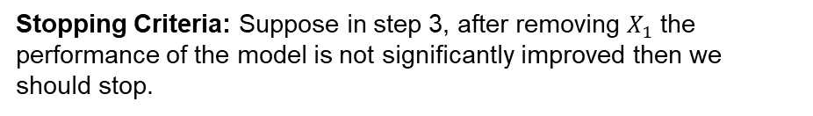
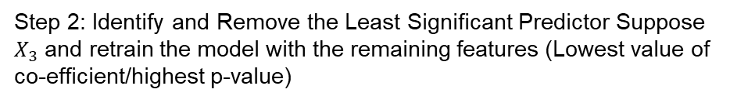




Observation | X1 | X2 | X3 | Y
1 | 1 | 2 | 4 | 5
2 | 2 | 4 | 6 | 7
3 | 3 | 6 | 8 | 9
4 | 4 | 8 | 10 | 11
5 | 5 | 10 | 12 | 13
Backward Selection
Step 1: Start with the Full Model
$Y=β_{0}$+${ β}_{1}X_{1}+β_{2}X_{2}+β_{3}X_{3}$
Step 2: Identify and Remove the Least Significant Predictor Suppose $X_{3}$ and retrain the model with the remaining features (Lowest value of co-efficient/highest p-value)
Stopping Criteria: Suppose in step 3, after removing $X_{1}$ the performance of the model is not significantly improved then we should stop.
$Y=β_{0}$+$β_{1}X_{1}+β_{2}X_{2}$
$Y=β_{0}$+$β_{1}X_{1}+β_{2}X_{2}$
$X_{2}$ & $X_{3}$ shall be used to train the model. These are the selected features
Step 3: : Identify and Remove the Least Significant Predictor Suppose $X_{1}$ and retrain the model with the remaining features
$Y=β_{0}$+ $β_{2}X_{2}$

Slide 15
Comparison
Aspect | Filter Methods | Wrapper Methods
Dependence on Model | Independent of the model | Dependent on the model
Computation | Fast and computationally inexpensive | Slower and computationally expensive
Accuracy | May not capture feature interactions | Captures feature interactions, usually more accurate
Overfitting Risk | Lower risk of overfitting | Higher risk of overfitting
Suitability | Good for high-dimensional datasets | Suitable when computational resources are available
Filter Methods: Preferable when you have a very large number of features and need a quick, general assessment of feature relevance.
Wrapper Methods: Better suited for situations where model accuracy is critical and computational resources allow for the intensive process of training and evaluating multiple models.

Slide 16
Thank You

